Slide 1
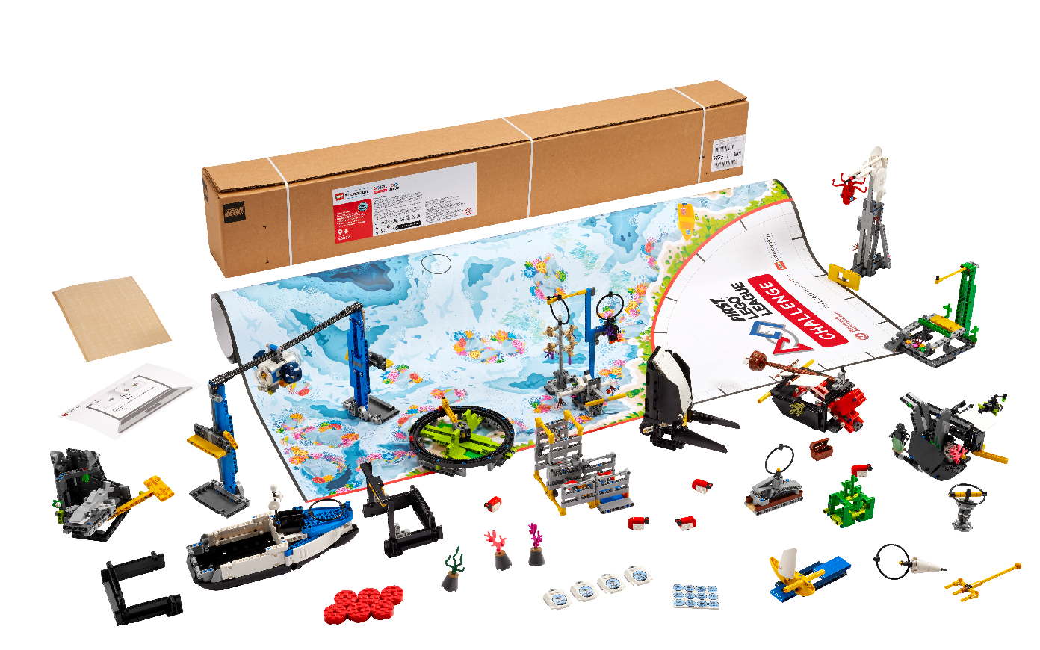


Session 7
Create Solutions
Notes:
Facilitator Tips - By embracing the Core Values, the team learns that friendly competition and mutual gain are not separate goals and that helping one another is the foundation of teamwork.
Session 7 Tips =
Check the team knows the Core Values and understands what Gracious Professionalism® is.
Different members of the team can be responsible for specific missions and develop and own the robot run for those missions.
When the team has a base robot, do a straight drive test. If it doesn’t go straight, look at the robot’s center of gravity and balance.
Have the team determine which launch area will be the starting position and make sure there is enough room for the whole robot to fit inside the launch area.
Encourage the students to explain the program as the robot moves.

Slide 2
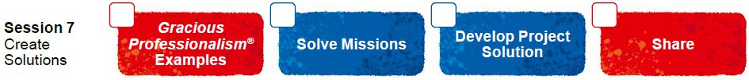
Session Overview
Outcomes
Begin to create their innovation project solution and complete the Innovation Project Planning page.
Design and iterate on their robot to complete additional robot game missions.
Notes:
Session Outcomes
Begin to create their innovation project solution and complete the Innovation Project Planning page.
Design and iterate on their robot to complete additional robot game missions.
Facilitator Tips - By embracing the Core Values, the team learns that friendly competition and mutual gain are not separate goals and that helping one another is the foundation of teamwork.
Session 7 Tips =
Check the team knows the Core Values and understands what Gracious Professionalism® is.
Different members of the team can be responsible for specific missions and develop and own the robot run for those missions.
When the team has a base robot, they should do a straight drive test. If it doesn’t go straight, look at the robot’s center of gravity and balance.
Have the team determine which launch area will be the starting position and make sure there is enough room for the whole robot to fit inside the launch area.
Encourage the students to explain their program as the robot moves and make notes about what they observe during testing.
Arrange a visit to look at examples in your community that can be a focus of the project.
A sketch can include a detailed annotated drawing or a computer-aided design (CAD) drawing.
Provide a variety of materials for the team to use to make a prototype or model of their project solution.
Have the team think of people (audience or experts) they would like to get feedback from on their solution.

Slide 3
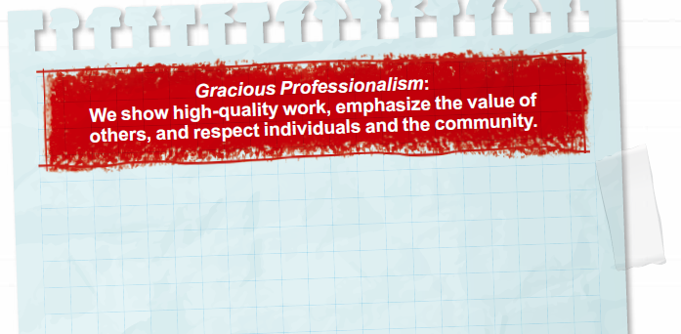
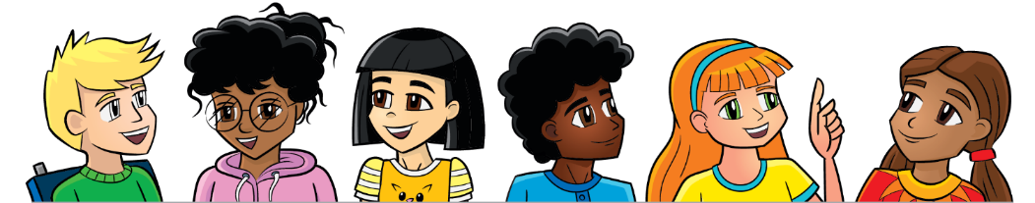
Introduction
Think about Gracious Professionalism®.
Write ways your team will demonstrate this in everything you do.
Notes:
Session Outcomes
Begin to create their innovation project solution and complete the Innovation Project Planning page.
Design and iterate on their robot to complete additional robot game missions.
Facilitator Tips - By embracing the Core Values, the team learns that friendly competition and mutual gain are not separate goals and that helping one another is the foundation of teamwork.
Session 7 Tips =
Check the team knows the Core Values and understands what Gracious Professionalism® is.
Different members of the team can be responsible for specific missions and develop and own the robot run for those missions.
When the team has a base robot, they should do a straight drive test. If it doesn’t go straight, look at the robot’s center of gravity and balance.
Have the team determine which launch area will be the starting position and make sure there is enough room for the whole robot to fit inside the launch area.
Encourage the students to explain their program as the robot moves and make notes about what they observe during testing.
Arrange a visit to look at examples in your community that can be a focus of the project.
A sketch can include a detailed annotated drawing or a computer-aided design (CAD) drawing.
Provide a variety of materials for the team to use to make a prototype or model of their project solution.
Have the team think of people (audience or experts) they would like to get feedback from on their solution.

Slide 4
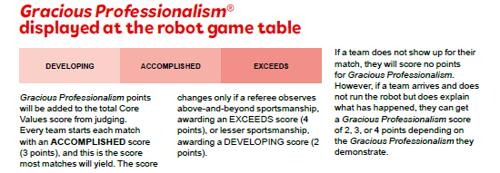
Introduction
Look at page 14 in the Robot Game Rulebook to see how Gracious Professionalism® is evaluated during the tournament.
Notes:
Session Outcomes
Begin to create their innovation project solution and complete the Innovation Project Planning page.
Design and iterate on their robot to complete additional robot game missions.
Facilitator Tips - By embracing the Core Values, the team learns that friendly competition and mutual gain are not separate goals and that helping one another is the foundation of teamwork.
Session 7 Tips =
Check the team knows the Core Values and understands what Gracious Professionalism® is.
Different members of the team can be responsible for specific missions and develop and own the robot run for those missions.
When the team has a base robot, they should do a straight drive test. If it doesn’t go straight, look at the robot’s center of gravity and balance.
Have the team determine which launch area will be the starting position and make sure there is enough room for the whole robot to fit inside the launch area.
Encourage the students to explain their program as the robot moves and make notes about what they observe during testing.
Arrange a visit to look at examples in your community that can be a focus of the project.
A sketch can include a detailed annotated drawing or a computer-aided design (CAD) drawing.
Provide a variety of materials for the team to use to make a prototype or model of their project solution.
Have the team think of people (audience or experts) they would like to get feedback from on their solution.

Slide 5
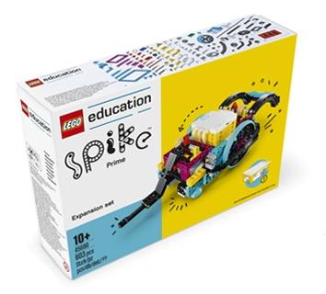
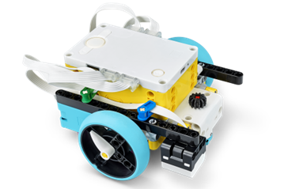
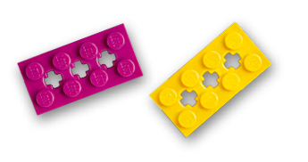
Solve Missions
Continue to develop your robot and its attachments to complete missions in the Robot Game.
You can improve the existing robot used in the previous sessions or create a new design.
Notes:
Team Tasks (100-120 minutes)
URL for SPIKE on-line: https://spike.legoeducation.com (remember to use a Chrome browser)
Session Outcomes
Begin to create their innovation project solution and complete the Innovation Project Planning page.
Design and iterate on their robot to complete additional robot game missions.
Facilitator Tips - By embracing the Core Values, the team learns that friendly competition and mutual gain are not separate goals and that helping one another is the foundation of teamwork.
Session 7 Tips =
Check the team knows the Core Values and understands what Gracious Professionalism® is.
Different members of the team can be responsible for specific missions and develop and own the robot run for those missions.
When the team has a base robot, they should do a straight drive test. If it doesn’t go straight, look at the robot’s center of gravity and balance.
Have the team determine which launch area will be the starting position and make sure there is enough room for the whole robot to fit inside the launch area.
Encourage the students to explain their program as the robot moves and make notes about what they observe during testing.
Arrange a visit to look at examples in your community that can be a focus of the project.
A sketch can include a detailed annotated drawing or a computer-aided design (CAD) drawing.
Provide a variety of materials for the team to use to make a prototype or model of their project solution.
Have the team think of people (audience or experts) they would like to get feedback from on their solution.

Slide 6
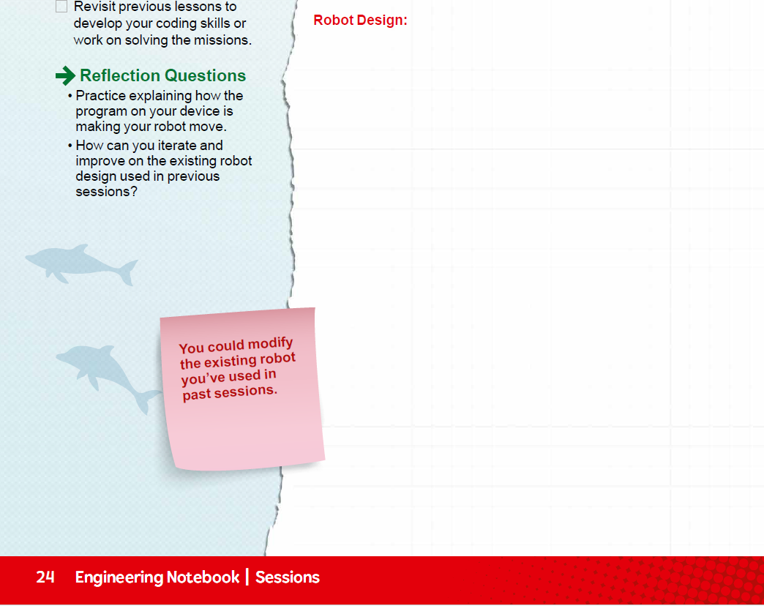
Solve Missions
Create a program for each new mission you attempt. You could combine mission solutions into one program.
Test and improve your robot and its programs.
Revisit previous lessons to develop your coding skills or work on solving the missions.
Notes:
Team Tasks (100-120 minutes)
Session Outcomes
Begin to create their innovation project solution and complete the Innovation Project Planning page.
Design and iterate on their robot to complete additional robot game missions.
Facilitator Tips - By embracing the Core Values, the team learns that friendly competition and mutual gain are not separate goals and that helping one another is the foundation of teamwork.
Session 7 Tips =
Check the team knows the Core Values and understands what Gracious Professionalism® is.
Different members of the team can be responsible for specific missions and develop and own the robot run for those missions.
When the team has a base robot, they should do a straight drive test. If it doesn’t go straight, look at the robot’s center of gravity and balance.
Have the team determine which launch area will be the starting position and make sure there is enough room for the whole robot to fit inside the launch area.
Encourage the students to explain their program as the robot moves and make notes about what they observe during testing.
Arrange a visit to look at examples in your community that can be a focus of the project.
A sketch can include a detailed annotated drawing or a computer-aided design (CAD) drawing.
Provide a variety of materials for the team to use to make a prototype or model of their project solution.
Have the team think of people (audience or experts) they would like to get feedback from on their solution.

Slide 7
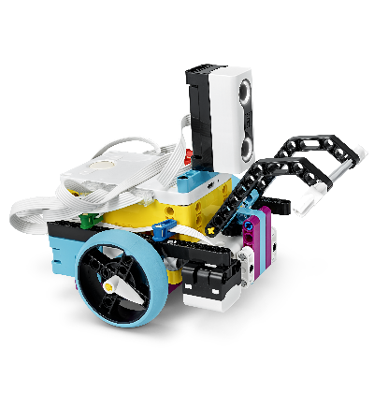

Reflection Questions
Practice explaining how the program on your device is making your robot move.
How can you iterate and improve on the existing robot design used in previous sessions?
Notes:
Team Tasks (100-120 minutes)
Session Outcomes
Begin to create their innovation project solution and complete the Innovation Project Planning page.
Design and iterate on their robot to complete additional robot game missions.
Facilitator Tips - By embracing the Core Values, the team learns that friendly competition and mutual gain are not separate goals and that helping one another is the foundation of teamwork.
Session 7 Tips =
Check the team knows the Core Values and understands what Gracious Professionalism® is.
Different members of the team can be responsible for specific missions and develop and own the robot run for those missions.
When the team has a base robot, they should do a straight drive test. If it doesn’t go straight, look at the robot’s center of gravity and balance.
Have the team determine which launch area will be the starting position and make sure there is enough room for the whole robot to fit inside the launch area.
Encourage the students to explain their program as the robot moves and make notes about what they observe during testing.
Arrange a visit to look at examples in your community that can be a focus of the project.
A sketch can include a detailed annotated drawing or a computer-aided design (CAD) drawing.
Provide a variety of materials for the team to use to make a prototype or model of their project solution.
Have the team think of people (audience or experts) they would like to get feedback from on their solution.

Slide 8
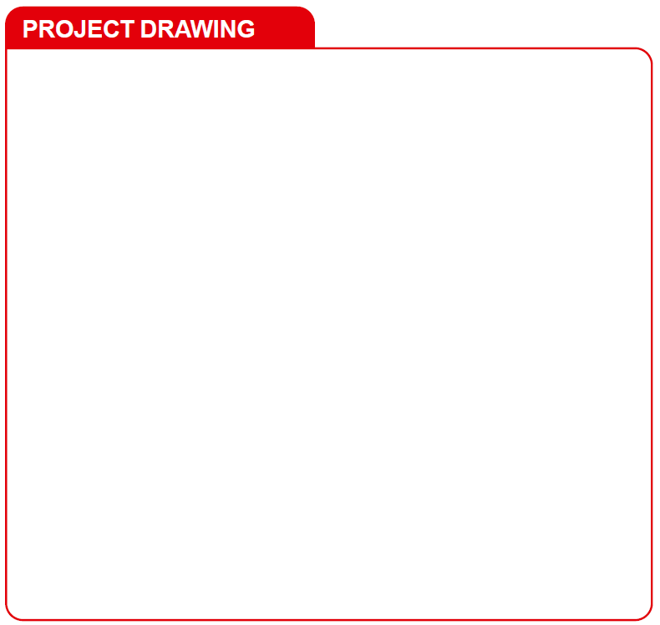
Develop Project Solution
Develop and create your Innovation Project solution.
Sketch your solution. Label the parts and how it will work.
Notes:
Team Tasks (100-120 minutes)
Session Outcomes
Begin to create their innovation project solution and complete the Innovation Project Planning page.
Design and iterate on their robot to complete additional robot game missions.
Facilitator Tips - By embracing the Core Values, the team learns that friendly competition and mutual gain are not separate goals and that helping one another is the foundation of teamwork.
Session 7 Tips =
Check the team knows the Core Values and understands what Gracious Professionalism® is.
Different members of the team can be responsible for specific missions and develop and own the robot run for those missions.
When the team has a base robot, they should do a straight drive test. If it doesn’t go straight, look at the robot’s center of gravity and balance.
Have the team determine which launch area will be the starting position and make sure there is enough room for the whole robot to fit inside the launch area.
Encourage the students to explain their program as the robot moves and make notes about what they observe during testing.
Arrange a visit to look at examples in your community that can be a focus of the project.
A sketch can include a detailed annotated drawing or a computer-aided design (CAD) drawing.
Provide a variety of materials for the team to use to make a prototype or model of their project solution.
Have the team think of people (audience or experts) they would like to get feedback from on their solution.

Slide 9

Develop Project Solution
Describe your solution and explain how it solves the problem.
Create a prototype, model, or drawing of your solution.
Document the process you use to develop your solution on page 23, Innovation Project Planning.
Notes:
Team Tasks (100-120 minutes)
Session Outcomes
Begin to create their innovation project solution and complete the Innovation Project Planning page.
Design and iterate on their robot to complete additional robot game missions.
Facilitator Tips - By embracing the Core Values, the team learns that friendly competition and mutual gain are not separate goals and that helping one another is the foundation of teamwork.
Session 7 Tips =
Check the team knows the Core Values and understands what Gracious Professionalism® is.
Different members of the team can be responsible for specific missions and develop and own the robot run for those missions.
When the team has a base robot, they should do a straight drive test. If it doesn’t go straight, look at the robot’s center of gravity and balance.
Have the team determine which launch area will be the starting position and make sure there is enough room for the whole robot to fit inside the launch area.
Encourage the students to explain their program as the robot moves and make notes about what they observe during testing.
Arrange a visit to look at examples in your community that can be a focus of the project.
A sketch can include a detailed annotated drawing or a computer-aided design (CAD) drawing.
Provide a variety of materials for the team to use to make a prototype or model of their project solution.
Have the team think of people (audience or experts) they would like to get feedback from on their solution.

Slide 10

Share
Get together at the mat.
Show any missions you are working on or have completed.
Discuss your research and your Innovation Project solution.
Discuss the reflection questions.
Clean up your space.
Notes:
Share (10-15 minutes)
Session Outcomes
Begin to create their innovation project solution and complete the Innovation Project Planning page.
Design and iterate on their robot to complete additional robot game missions.
Facilitator Tips - By embracing the Core Values, the team learns that friendly competition and mutual gain are not separate goals and that helping one another is the foundation of teamwork.
Session 7 Tips =
Check the team knows the Core Values and understands what Gracious Professionalism® is.
Different members of the team can be responsible for specific missions and develop and own the robot run for those missions.
When the team has a base robot, they should do a straight drive test. If it doesn’t go straight, look at the robot’s center of gravity and balance.
Have the team determine which launch area will be the starting position and make sure there is enough room for the whole robot to fit inside the launch area.
Encourage the students to explain their program as the robot moves and make notes about what they observe during testing.
Arrange a visit to look at examples in your community that can be a focus of the project.
A sketch can include a detailed annotated drawing or a computer-aided design (CAD) drawing.
Provide a variety of materials for the team to use to make a prototype or model of their project solution.
Have the team think of people (audience or experts) they would like to get feedback from on their solution.

Slide 11

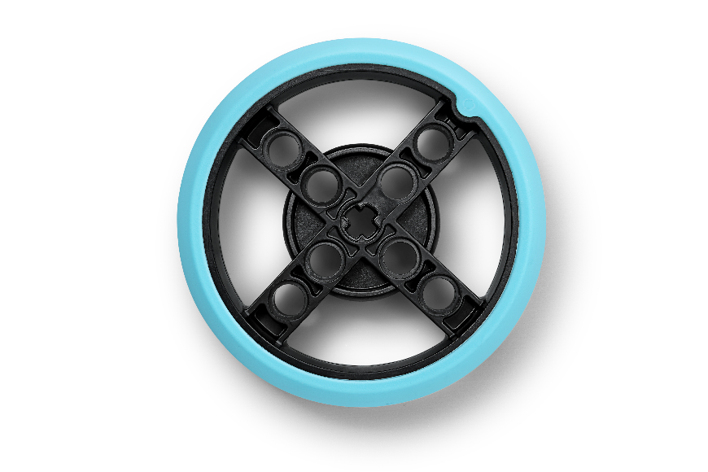
Reflection Questions
Can you describe your innovative solution in less than five minutes?
How does your solution address your identified problem?
Who can you share your solution with for feedback?
Notes:
Facilitator Tips
Session Outcomes
Begin to create their innovation project solution and complete the Innovation Project Planning page.
Design and iterate on their robot to complete additional robot game missions.
Facilitator Tips - By embracing the Core Values, the team learns that friendly competition and mutual gain are not separate goals and that helping one another is the foundation of teamwork.
Session 7 Tips =
Check the team knows the Core Values and understands what Gracious Professionalism® is.
Different members of the team can be responsible for specific missions and develop and own the robot run for those missions.
When the team has a base robot, they should do a straight drive test. If it doesn’t go straight, look at the robot’s center of gravity and balance.
Have the team determine which launch area will be the starting position and make sure there is enough room for the whole robot to fit inside the launch area.
Encourage the students to explain their program as the robot moves and make notes about what they observe during testing.
Arrange a visit to look at examples in your community that can be a focus of the project.
A sketch can include a detailed annotated drawing or a computer-aided design (CAD) drawing.
Provide a variety of materials for the team to use to make a prototype or model of their project solution.
Have the team think of people (audience or experts) they would like to get feedback from on their solution.

Slide 12

Multimedia Resources
You may wish to embed a relevant, age-appropriate video for your students here.
Notes:
Choose a relevant, age-appropriate video for your students.

Slide 13

Clean Up
Notes:
Allow time for cleanup and place any unfinished models and their pieces in a sealed plastic bag.
Clean Up Pointers
You may wish to play a video or song during clean up time Link on
GoNoodle: https://family.gonoodle.com/activities/clean-up
Link on YouTube Kids: https://www.youtubekids.com/watch?v=ZJFk87ZsHn0
Link on Youtube: https://youtu.be/ZJFk87ZsHn0

Slide 14


LEGO, the LEGO logo, the SPIKE logo, MINDSTORMS and the MINDSTORMS logo are trademarks of the/sont des marques de commerce du/son marcas registradas de LEGO Group. ©2024 The LEGO Group. All rights reserved/Tous droits réservés/Todos los derechos reservados. FIRST ®, the FIRST ® logo, Coopertition ®, Gracious Professionalism®, and FIRST® DIVESM are trademarks of For Inspiration and Recognition of Science and Technology (FIRST). LEGO® is a registered trademark of the LEGO Group. FIRST® LEGO® League and SUBMERGEDSM are jointly held trademarks of FIRST and the LEGO Group. All other trademarks are the property of their respective owners. ©2024 FIRST and the LEGO Group. All rights reserved.

